Slide 1
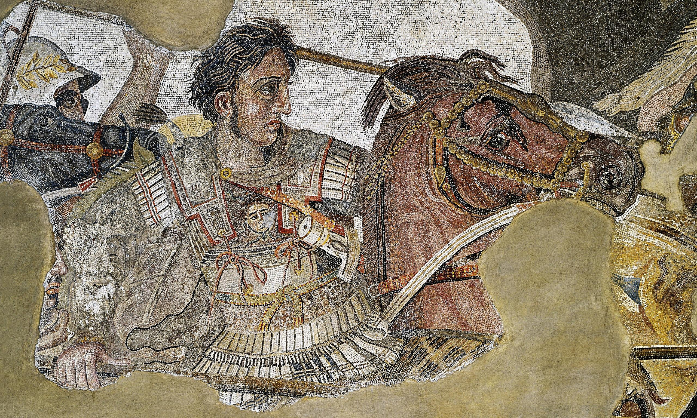
ATG - Review
Goal/s:
Review the Early Life of ATG
Week 1 Lesson 3 – unit 2
Ms Barrie

Slide 2
Week 1 and 2 Overview
Selected individual Syllabus Points – Alexander the Great
the background of the selected individual, including: ▪ family background ▪ key events in their lives ▪ significant early influences
the career of the selected individual, including: ▪ change of role or status over time ▪ possible motivations for actions ▪ methods used to achieve aims
relationships with other individuals, groups, structures/institutions; for example, military or religious ▪ significant events in their career ▪ ways they shaped and/or changed their society ▪ the manner and impact of their death
challenges presented by other individuals, groups and structures/institutions
motivation and actions of the other individuals, groups and structures/institutions, seeking to influence
structures of power within the society
the legacy of the selected individual, including: ▪ assessment of their life and career ▪ the ways they shaped and/or changed their society ▪ their longer-term impact and legacy

Slide 3
Overview of ATG – Week 1 and 2
Tuesday | Wednesday | Thursday | Friday
Poster | ATG - Legacy | SUMMARY Early Life | SUMMARY Key Battles
SUMMARY Methods/Aims | SUMMARY Impacts | SUMMARY Challenges | SUMMARY Legacy

Slide 4
INSTRUCTIONS
Cut out the label
Glue the label to the front of the folder
Using a marker/texta, write your name on the front of your review folder
This is where you will store all of your ATG review sheets

Slide 5
ATG’s Early Life
Summary topic one

Slide 6
Class Discussion
What do you already know about ATG’s Early Life?
Think about:
Key people – early influences
Key events – battles, biography
Key ideas – beliefs and values
FILL IN YOUR MIND MAP

Slide 7
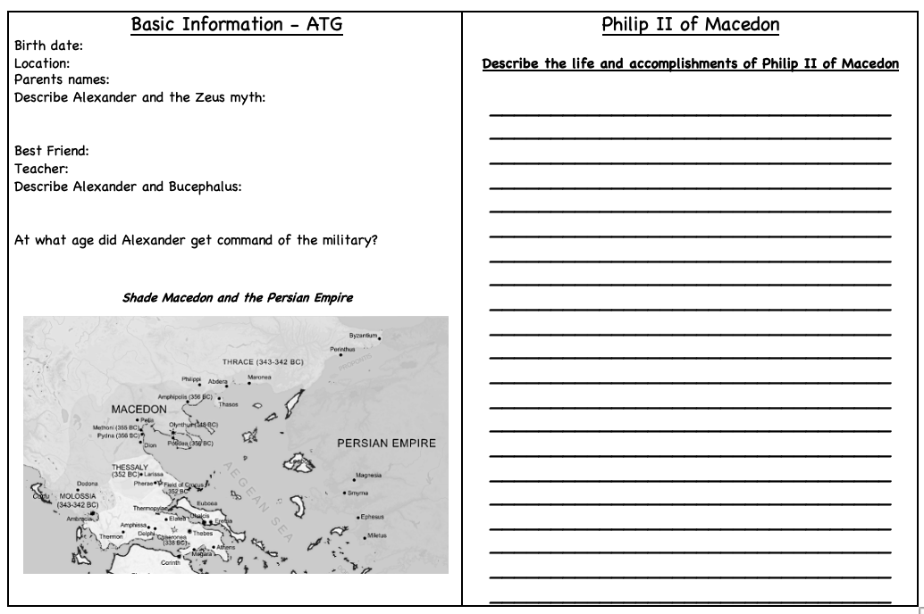
Alexander the Great – Basic Information
Fill in the key information about Alexander the Great’s Early Life

Slide 8
Writing Responses
How did Alexander GAIN power:
How did Alexander RISE to power:
How did Alexander SOLIDIFY power:

